Slide 1
Let’s talk about failure
Eric Weiss’s declaration of independence anecdote

Slide 2
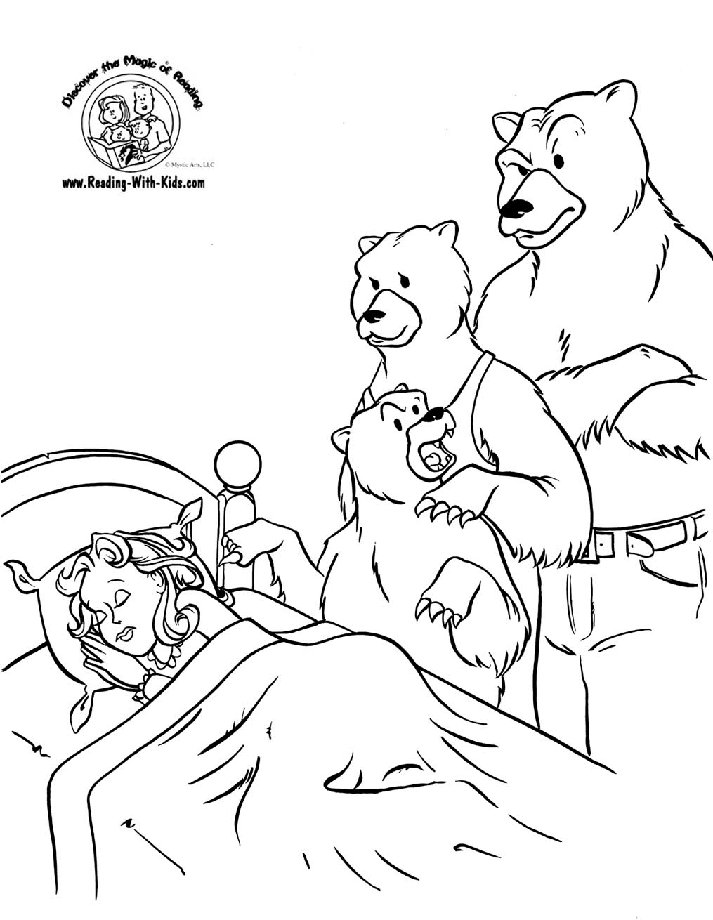
2 reasons for failure

Slide 3
The Usual suspects
Slackin’ off
Over trained (Know pain vs. Discomfort)
Poor dieting
Body got bored
Time factor/Sleep

Slide 4
Have they succeeded?

Slide 5
People get hurt
The issue
• Too broad a spectrum, no variety in programs
No gradual build, start out to hectic
Overtraining exists, Insanity has ruined the interval method
http://scoobysworkshop.com/overtraining/

Slide 6
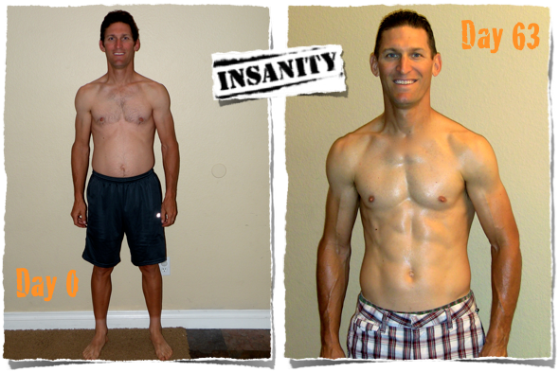
http://teamripped.com/wp-content/uploads/2010/08/day-1-150-front.jpg
P90X
http://www.fitmarriage.com/exercise/insanity-results

Slide 7
Nutrition programs of the past that do not work
The focus diets/no-no
The “miracle food diet”
Fasting/low cal diets

