Slide 1
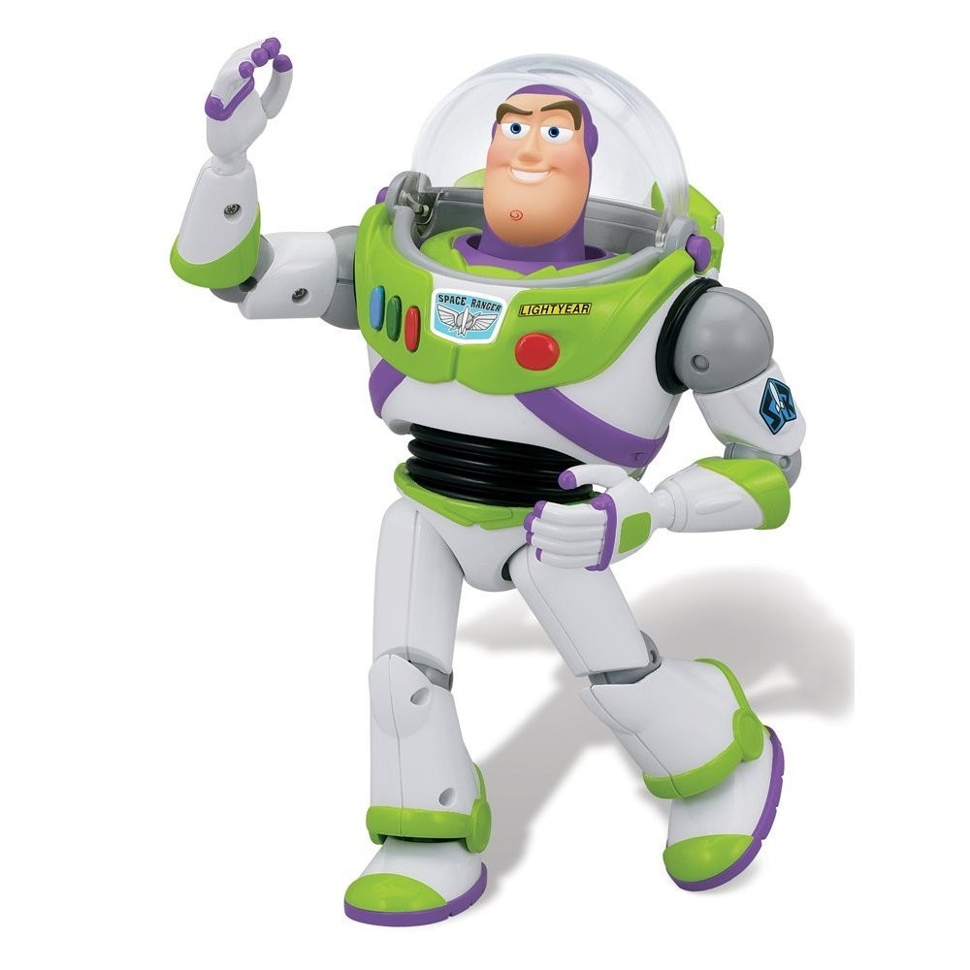

Slide 2
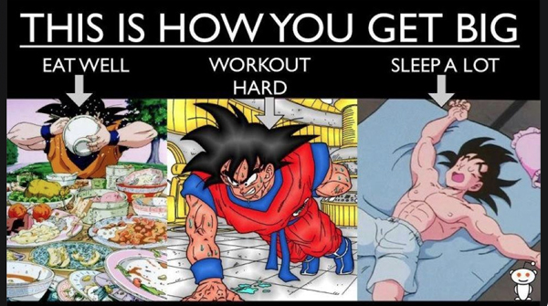

Slide 3
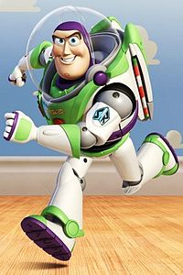
Happiness should not be a destination, it should be the mean of travel
_{H2}
Happy Healthy
Happiness

Slide 4
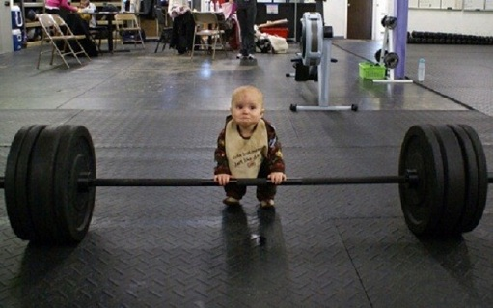
Where is your H2?

Slide 5
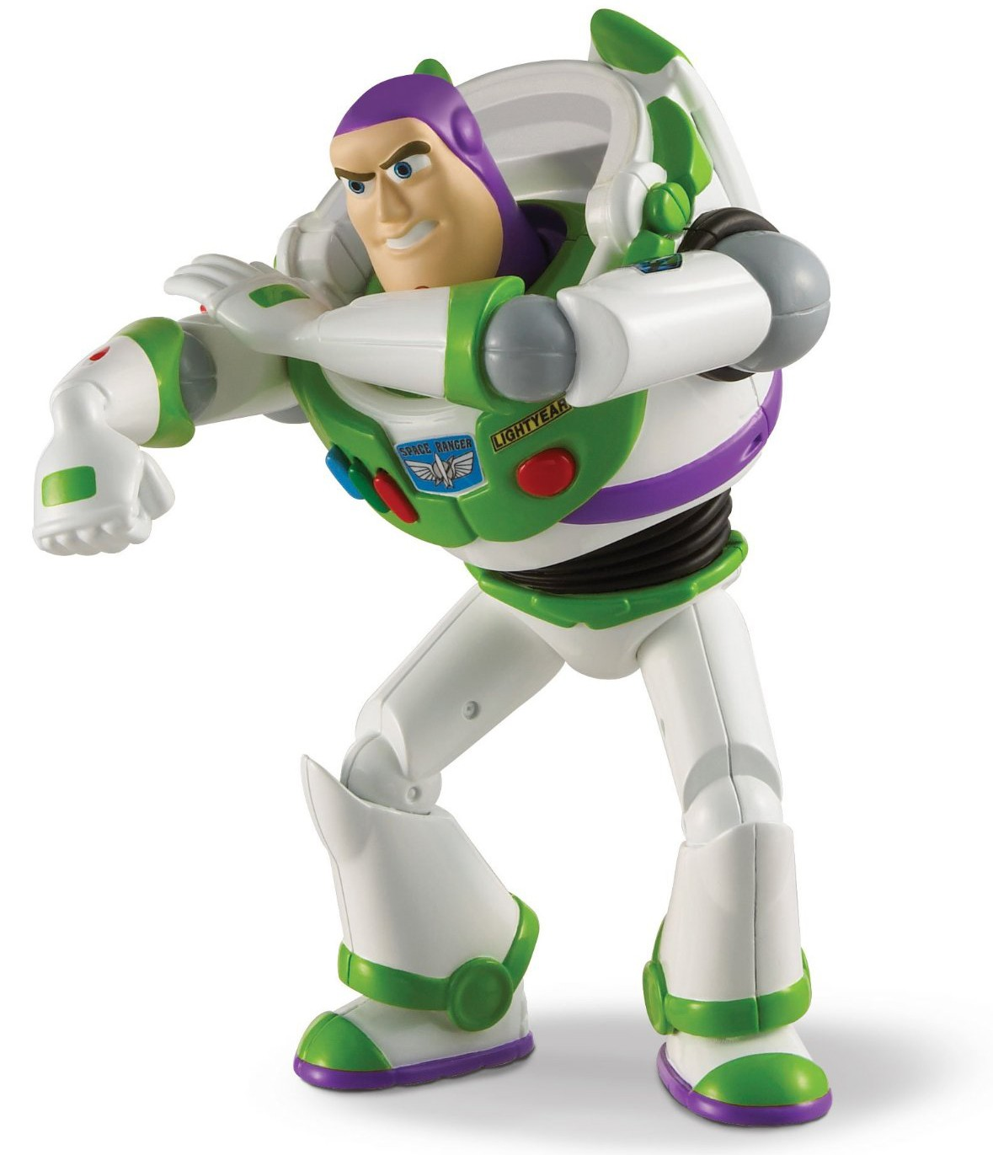
The first attempt
1 program 21 volunteers
Easily applicable… they said

Slide 6
Train
Basic, Challenging, Hardcore
Balance
Cardio + Resistance training = Complete workout

Slide 7
Dynamic Warm-up
Resistance training
Cardio
Cool down

Slide 8
Nutrition
8 major guidelines - not a diet
“Your foods”
• Reading labels
Eating at restaurants

Slide 9
Measuring the results
The content factor
Satisfied with athletic profile
Before and After survey
Healthier lifestyle = Happier life?

Slide 10
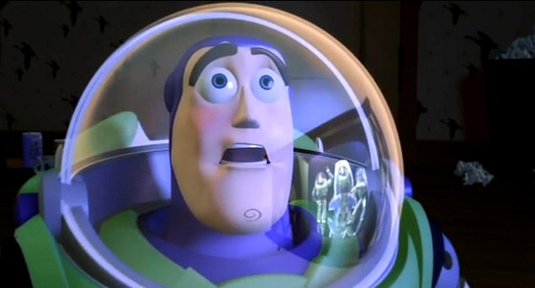
Kinda..

Slide 13
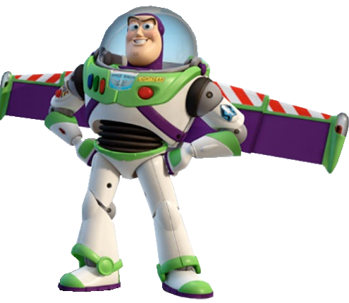
25 girls
25 guys
5 questions

Slide 14
Frequency?
• Eat clean? Watch health outside gym?
Least favorite part?
• Happy after a workout? Happier in general because you workout?
What do you use for motivation?

Slide 15
SYP style

Slide 16
Eating Clean?
A) 60%
B) 10%
C) 35%

Slide 17
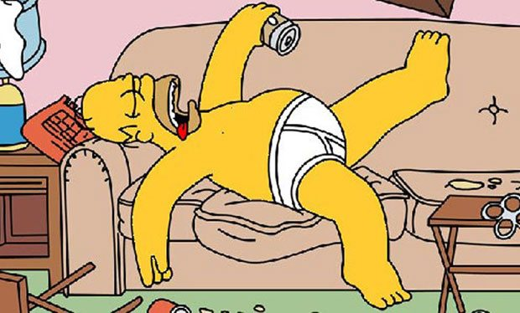
Worst part about working out?
Finding time
Getting motivated
Being hot and sweaty and breathing heavily

Slide 18
Happier after a workout?
What percent said yes?
80% (40/50 kids) agreed
8 Mentioned NOT feeling good when they couldn't workout
8 kids also mentioned confidence, mood and morality

Slide 19
What is your motivation?
Top answer?
1) Wanting to have an attractive body (or specific body part that I would rather not mention)
2) “Bikini/beach season” or an upcoming vacation
3) Competing with someone else

Slide 20
Motivation tips for you
Favorite athlete
• Motivational workout videos
Health related fitness pages
Think about what you WILL look like
Think about what you will look like if you don’t workout (or eat well)
Music during or before

Slide 21
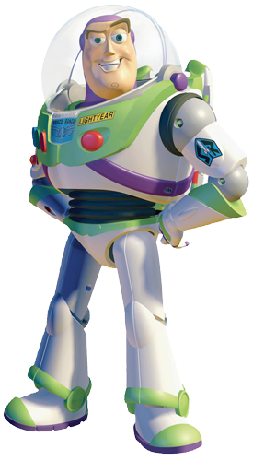
Eric explains stuff

Slide 22
Active passion

Slide 23
Active passion ± gym = Happy Healthy
Your happy healthy will be where your goal does not exceed your capability and your capability does not interfere with your active passion.

Slide 24
Planning a fun road trip

Slide 25
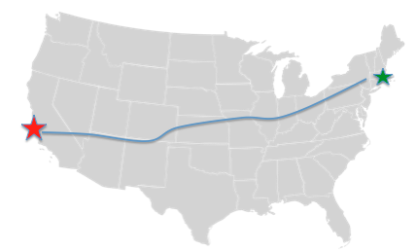
Identify goal to ROUTE

Slide 26
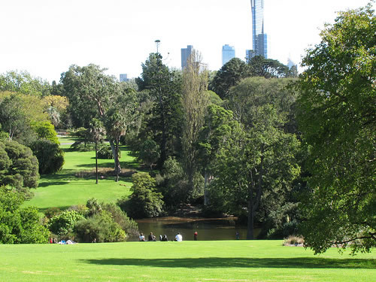
IDENTIFY PASSION

Slide 27
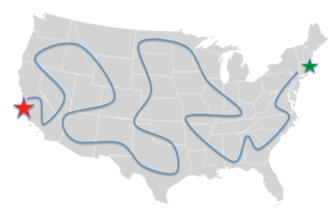
MODIFY YOUR SCHEDUAL TO INCLUDE PASSION

Slide 28
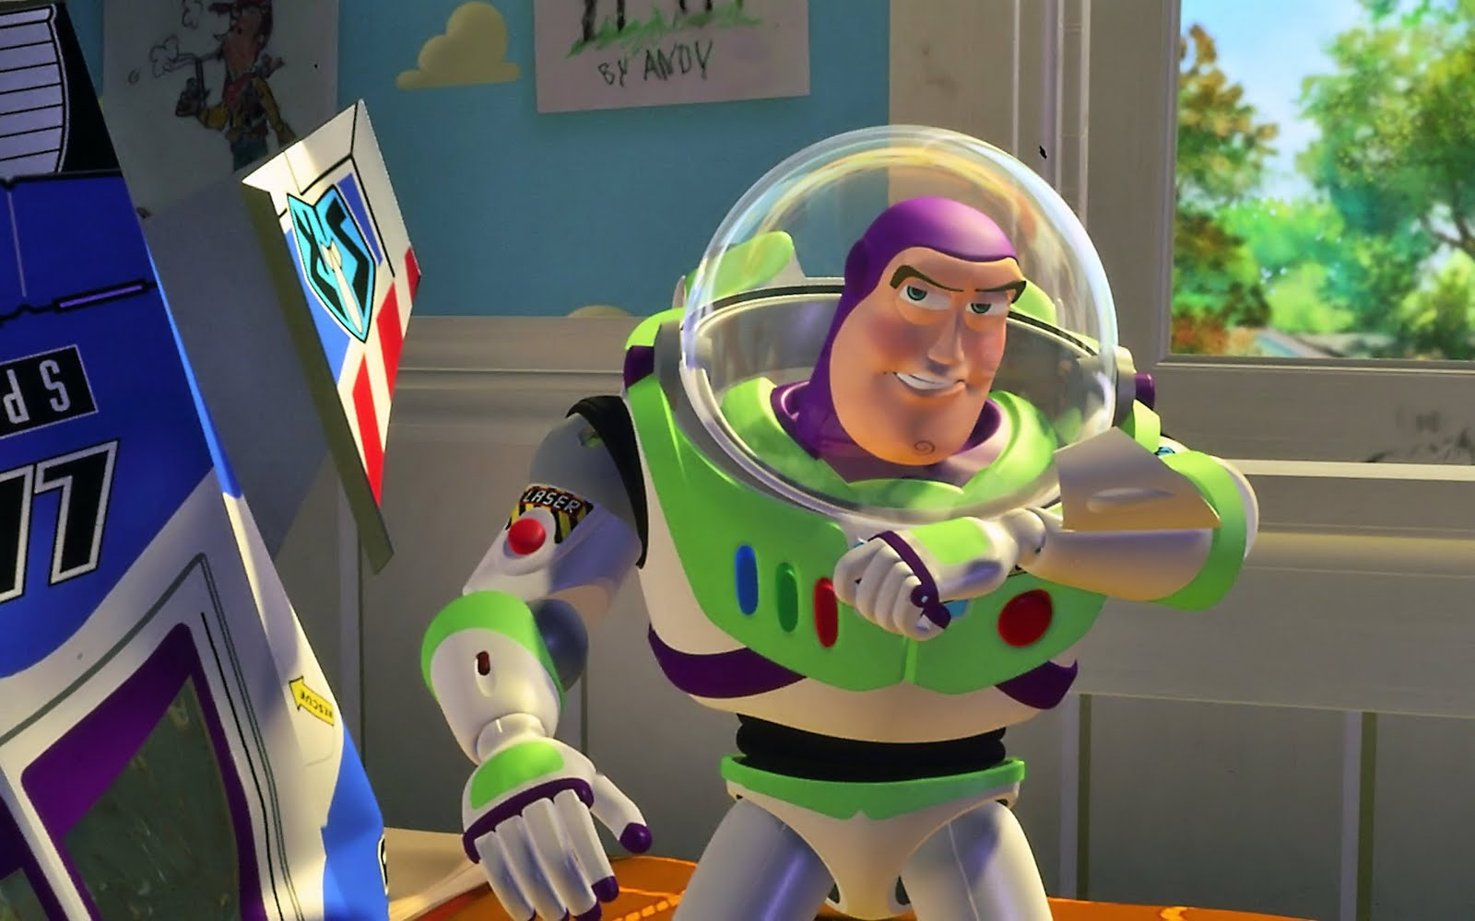
MODIFY GOAL

Slide 29
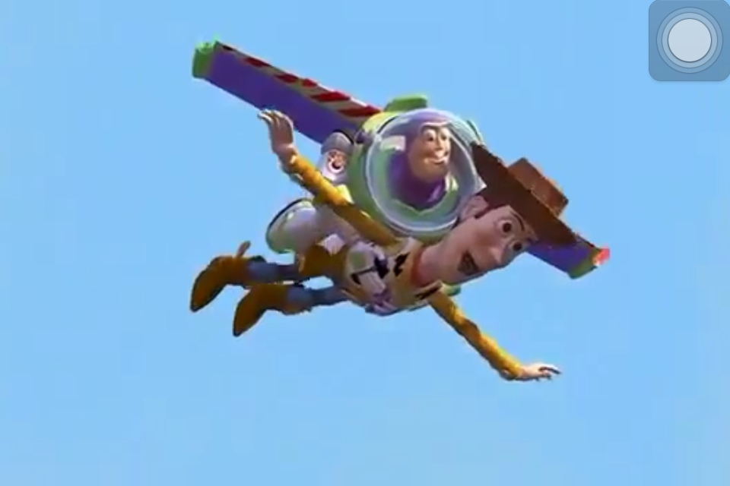
SUCCEED

Slide 33
Big 5 Checklist for H2
Buddy Up!
Use your body
Puzzle your plate
Snack with gusto
5) Drink water NOT soda

Slide 35
Eaweiss@me.com
Thank you!

