Slide 1
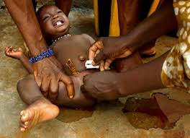
Genital Mutilation
Eric Weiss

Slide 2
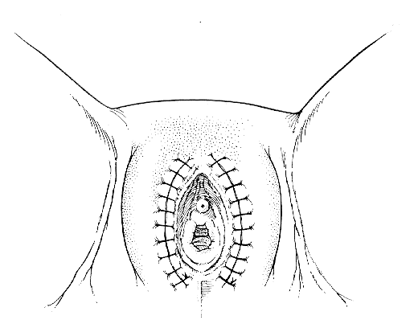
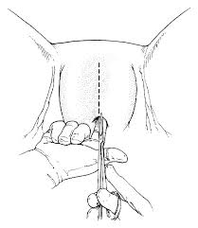
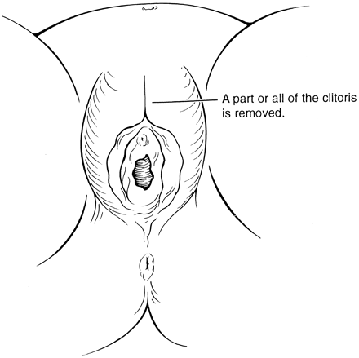
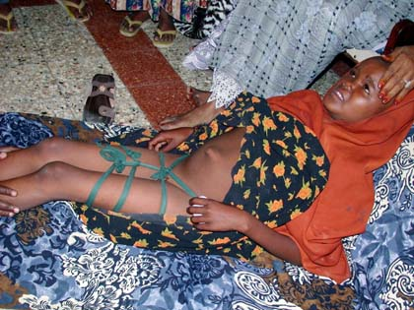
The Facts
• Circumcision ≠ GM
• Eunuchs
• FGM/FGC is non medical
•Young
• Unsterile and often W/out anesthetics
• 3 types of FGM procedures

Slide 3
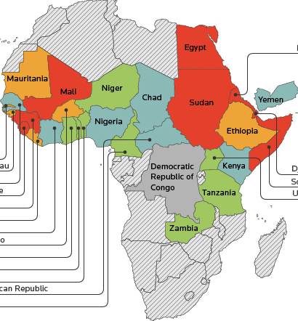
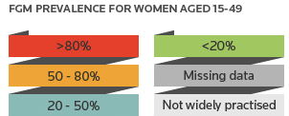
Where and Why?
Ethnic cultural practice
Predominantly Africa
Middle East
Study by UNICEF@ in 2012.

Slide 4
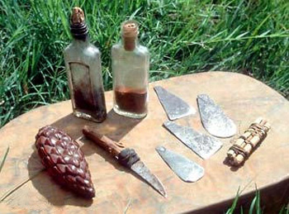
Reality of the situation
Great risks for women
There are strikes and protests
“Peer pressure”

